Slide 1
EXAMINING THE SHOULDER

Slide 2
IT CAN BE COMPLICATED…….
WHY…..?
Many pathologies cause shoulder pain
Many of the 129 (!) Clinical tests NOT specific or sensitive in isolation
Soft tissue damage does not correlate with functional deficits

Slide 3
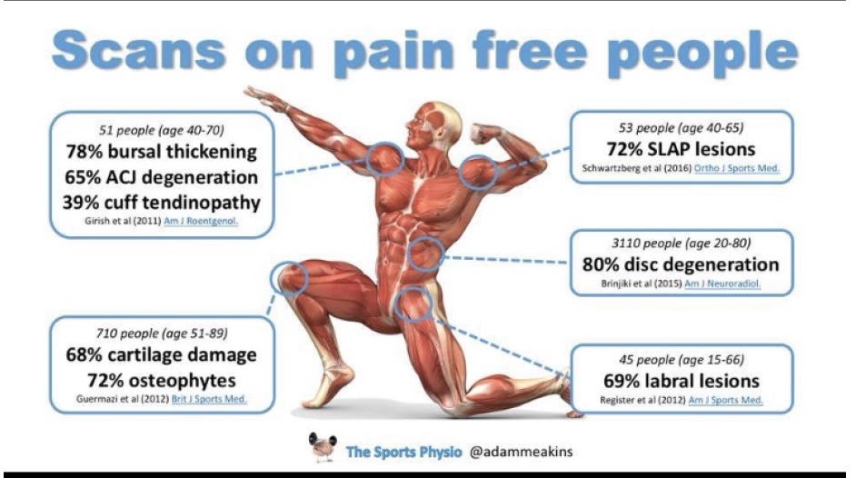
Ref: Adam Meakins / The Sports Physio

Slide 4
BUT……..We can simplify things
Painful Shoulders are generally either…..
  STIFF and painful
  WEAK and painful
  UNSTABLE and painful

Slide 5
Three criteria can help guide management
History of trauma
Age
Shoulder external rotation test

Slide 6
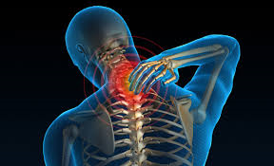
But first…..CLEAR THE NECK
Is it even the shoulder?
  Pain on neck movement
  Neural symptoms
  +ve Spurlings test

Slide 7
STIFF and Painful…..
Age = >40
Trauma = No
Ext Rotation = REDUCED BOTH
  ACTIVE & PASSIVE
  Dx = OA or Frozen Shoulder (normal age range 40-60)
  Mx = XR (not USS)
  Capsulitis: Physio/Hydrodilatation. Ortho if not coping.
  OA: Injection (Glenohumeral), Ortho if not coping

Slide 8
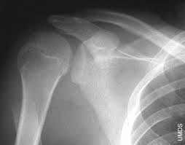
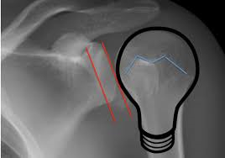
STIFF and Painful…..
Age = any
Trauma = YES
Ext Rotation = REDUCED BOTH
  ACTIVE & PASSIVE
  Dx = Missed # or dislocation
  Mx = XR (not USS)/Ortho

Slide 9
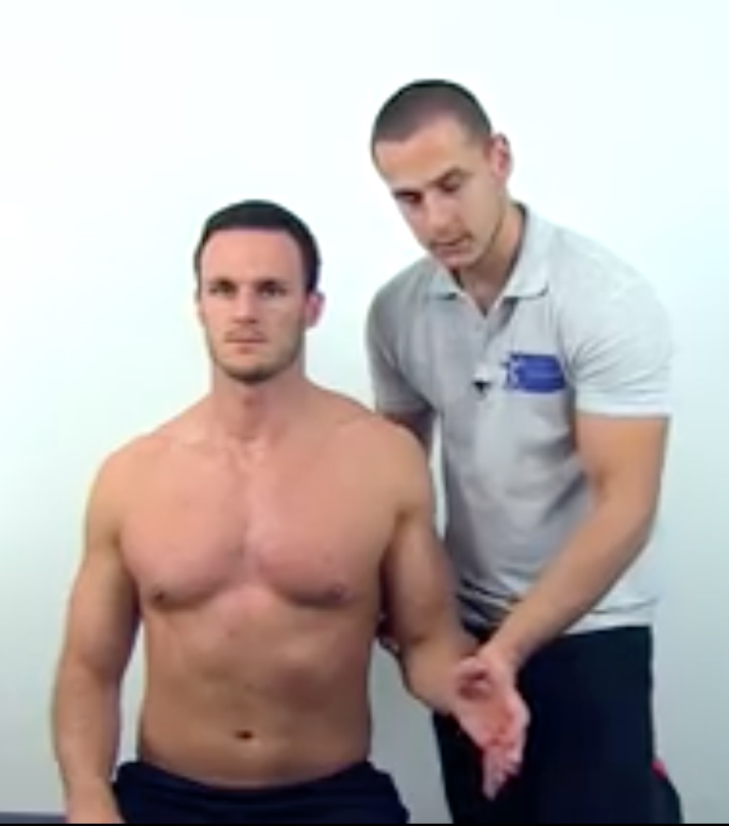
WEAK and Painful…..
Age = 30+
Trauma = NO
External rotation test = WEAK/PAINFUL on resisted testing
Dx = Rotator cuff tendinopathy
Mx = Physio – BESS guidelines suggest 6-12/52
Ref: Physiotutors

Slide 10
Rotator Cuff tendinopathy
Other signs…..
+ve painful arc
+ve Hawkins Kennedy
+ve Neer
Pain/weak Full/empty can
Pain/weak external rotation test
>3 +ve tests = +LR2.93

Slide 11
WEAK and Painful…..
Age = >50
Trauma = YES
External rotation test = WEAK/PAINFUL on resisted tests
Dx = Rotator Cuff Tear
Mx = Refer Ortho

Slide 12
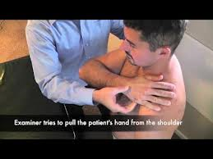
Subscapularis Tear
Trauma
Loss of internal rotation strength
Positive bear hug/lift off test
Urgent USS and Orthopaedic referral

Slide 13
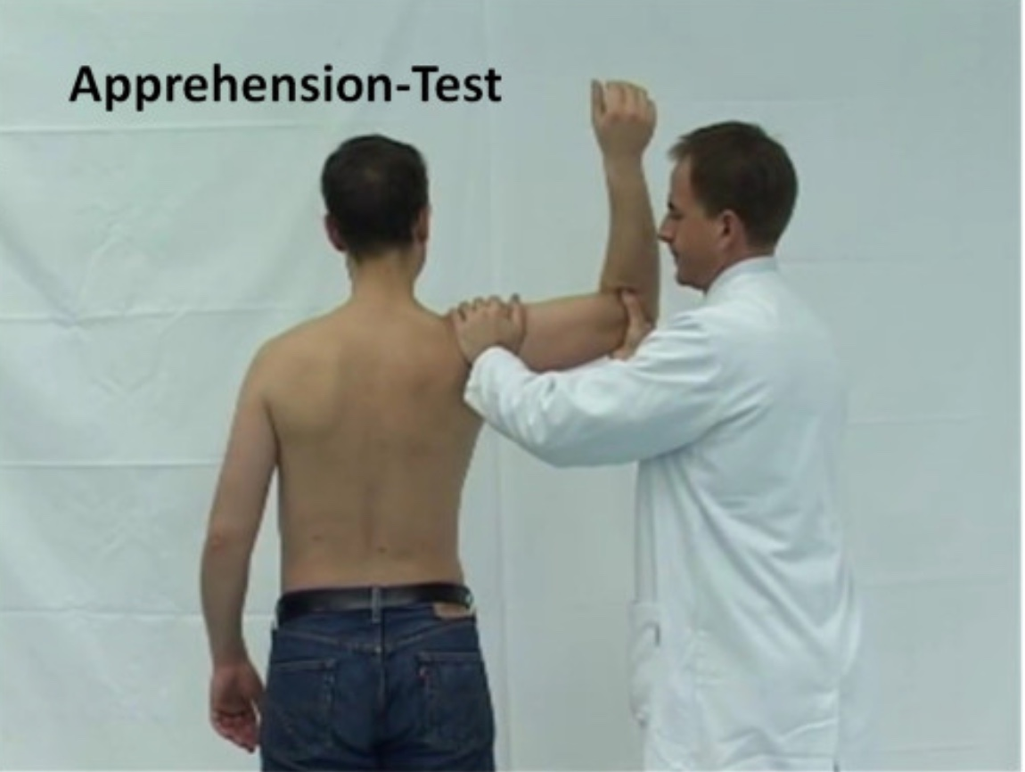
UNSTABLE and Painful
Trauma = NO
Age = 20 +
External rotation test in abduction = Pain or APPREHENSION
Dx = Atraumatic instability
Mx = Refer Physio
Ref: Researchgate.net

Slide 14
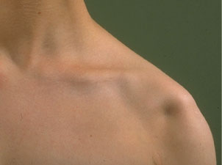
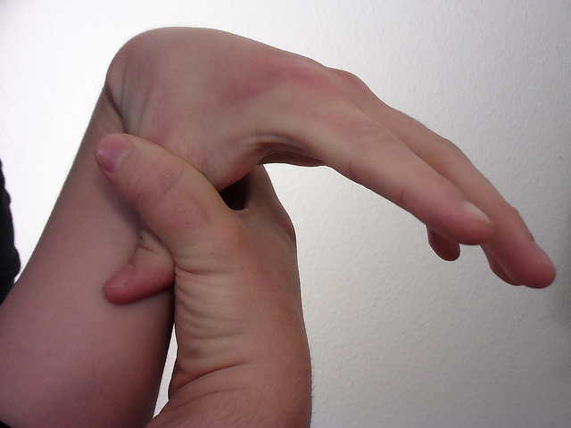
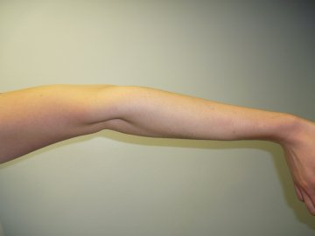
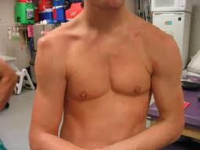
Instability
Atraumatic
PHYSIOTHERAPY
((+/- Surgery))

Slide 15
UNSTABLE and Painful…..
Trauma = YES
Age = ANY
External rotation test in abduction = Pain or APPREHENSION
Dx = Structural defect
Mx = Ortho/physio

Slide 16
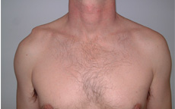
ACJ Disorders
Acute
Chronic
Acute
Displaced
Athlete
Young manual
Consider surgery 2/52
Displaced
Symptomatic
or OA
Consultation

Slide 17
Summary
Is the painful shoulder
  Stiff think frozen shoulder/OA/missed dislocation
  Weak think rotator cuff tendinopathy/tear
  Unstable think congenital/structural defect
Use three simple criteria to decide management
  Trauma
  Age
  External rotation test

Slide 18
BESS.org.uk

